Slide 1




Answering pattern queries using views
Wenfei Fan
Xin Wang
Yinghui Wu
University of Edinburgh
Southwest Jiaotong University
UC Santa Barbara
Notes:
Title page.
Introduction.
Good morning everyone! I’m glad to be here with you today. And I’m going to
talk about big graph search and analytics. Feel free to interrupt me if you have any questions during my talk .

Slide 2
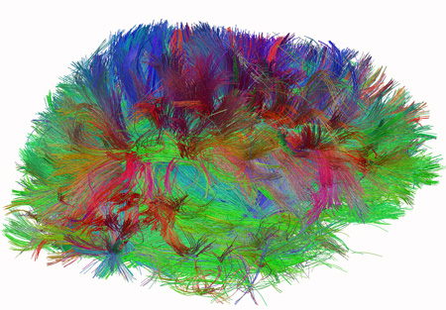
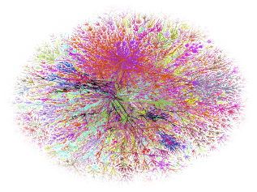
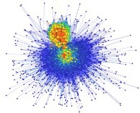





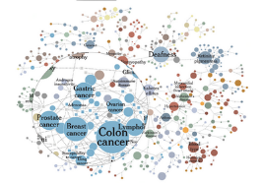

Real-life graph querying is expensive
100M(10⁸)
social scale
100B (10¹¹)
Web scale
1T (10¹²)
brain scale, 100T (10¹⁴)
Human Connectome,
The Human Connectome Project, NIH
Real-life scope
US
road
Internet
(Opte project)
knowledge
graph
Web graph
(Google)
BTC
Semantic Web
An NSA Big Graph experiment,
P.Burkhardt, et al, US. National Security Agency, May 2013
Notes:
The usability issue is not the only concern.
In this side I’m showing you a scope of graph size.
We may thought that facebook and Google knowledge graphs
are quite large with billions of nodes and edges. But web graphs
Are at the scale of 10 times larger, and our brain is 1000 times larger.
-benchmark: graph500: 2^37 <<10^14.
What’s more, these graphs are evolving. It is observed that real-life graphs follows the growth powerlaw found by Kleinbergh.
It suggests that the edge number grows superlinearly with the number of nodes.
Note that I’m only talking about the number of nodes and edges. I’m not talking about how large the data size is if presented in terabytes or petabytes
Things will get even more ugly if you think about first: the rich content associated to them.
This is not even the worst if you think about dynamic networks and multi-dimensional data.
They will make life much harder: 2T data are generated over a small network of 100 servers per day!
But where is our research now? You may ask. (pause) It’s here. (pause). The current scope of graph data research including several famous benchmarks
Like graph500 only reaches billions of nodes and edges. And this gives us the challenge of scalability: How to make big graph analytics efficient and scalable?

Slide 3









Querying collaborative network
customer 3
customer n
expensive!
…
project
manager
PM 1
PM 2
PM 2
PM 1
project
manager
tester
developer 2
customer 2
developer 3
customer
developer
developer 1
query 1
customer 2
developer 3
customer
developer
customer 2
customer 1
A collaborative pattern
…
developer 3
Customer
developer
customer 3
developer k
query 2
developer 2
customer 3
developer 2
A collaborative (chat) network
“Detecting Coordination Problems in Collaborative Software Development Environments”, Amrit Chintan et al, Information System management, 2010

Slide 4

Answering query using views
database
views V(D)
query A
A(V)
query result
When?
What to choose?
How to evaluate?
Q(D)
query result
query Q
database D
graph pattern query (bounded) simulation
(our work)
regular path queries
tree pattern query
relational algebra
XPath
XML
RDF/SPARQL
1995
1998
2000
2002
2006
2007
2011
Notes:
Challenge:

Slide 5
Outline
Graph pattern matching using views
  When, what and how?
When a query can be evaluated using views?
  Pattern containment: an iff condition
How to evaluate?
  query answering using views
What to choose?
  minimum containment & minimal containment
Extension: bounded simulation
Experimental Study
Conclusion
Notes:
Outline:

Slide 6
Graphs, patterns and views
view 1
binary relation
node match: satisfies predicates
edge match: connects two node matches
customer 2
edges | matches
(customer, developer) | {(customer 2, developer 2), (customer 3, developer 3)}
(developer, customer) | {(developer 2, customer 2), (developer 2, customer 3), (developer 3, customer 2)}
customer
developer
developer 3
customer
developer
pattern query
(view definition)
customer 3
view definition 1
developer 2
view extension 1
query result
view 2
edges | matches
(customer, developer) | {(customer 2, developer 2), (customer 3, developer 3)}
(developer, customer) | {(developer 2, customer 2), (developer 2, customer 3), (developer 3, customer 2)}
project
manager
edges | matches
(project manager, developer) | {(PM 1, developer 2), (PM 2, developer 3)}
(project manager, customer) | {(PM 1, customer 2), (PM 2, customer 2),
customer
developer
view definition 2
(view extension)
view extension 2
Notes:
Theories of answering queries using views, A.Y.Halevy, SIGMOD record.
We are not addressing rich semantics of node label; also we are not addressing integration.

Slide 7

Graph pattern matching using views
Given a pattern query Q, and a set V of view definitions, find another query A s.t.
  A is equivalent to Q (A(G) = Q(G)) for all data graph G
  A only refers to V and extensions V(G)
views V
query A
A(G)
Q(G)
matches
query Q
data graph G

Slide 8
When a pattern query can be answered using views?
Notes:
I stop here about my work on graph search. any questions?
Next I will use several slides to address my work on cyber network causality analysis as an important application of graph analytics.
This part of work is in collaboration with Army research lab and BBN company.

Slide 9
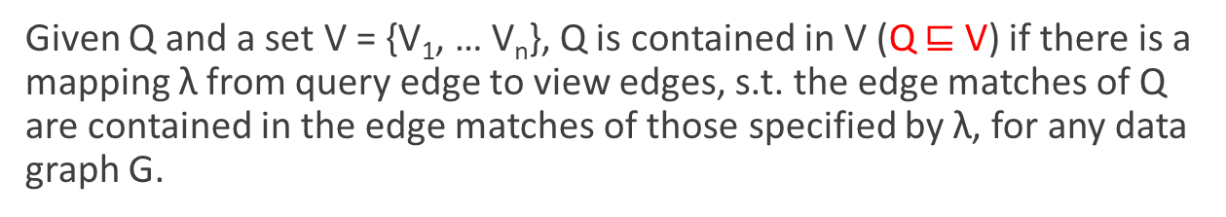



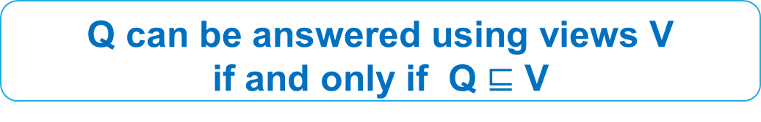



Pattern containment
project
manager
(project manager, developer) | (PM 1, developer 2)
(project manager, customer) | (PM 1, customer 2)
(developer, customer) | (developer 2, customer 2)
(customer, developer) | (customer 2, developer 2)
customer
developer
project
manager
View 1
Query result
View 2
customer
developer
customer
developer
(project manager, developer) | {(PM 1, developer 2), (PM 2, developer 3)}
(project manager, customer) | {(PM 1, customer 2), (PM 2, customer 2)}
(customer, developer) | {(customer 2, developer 2), (customer 3, developer 3)}
(developer, customer) | {(developer 2, customer 2), (developer 2, customer 3), (developer 3, customer 2)}
Notes:
Give a picture here.

Slide 10
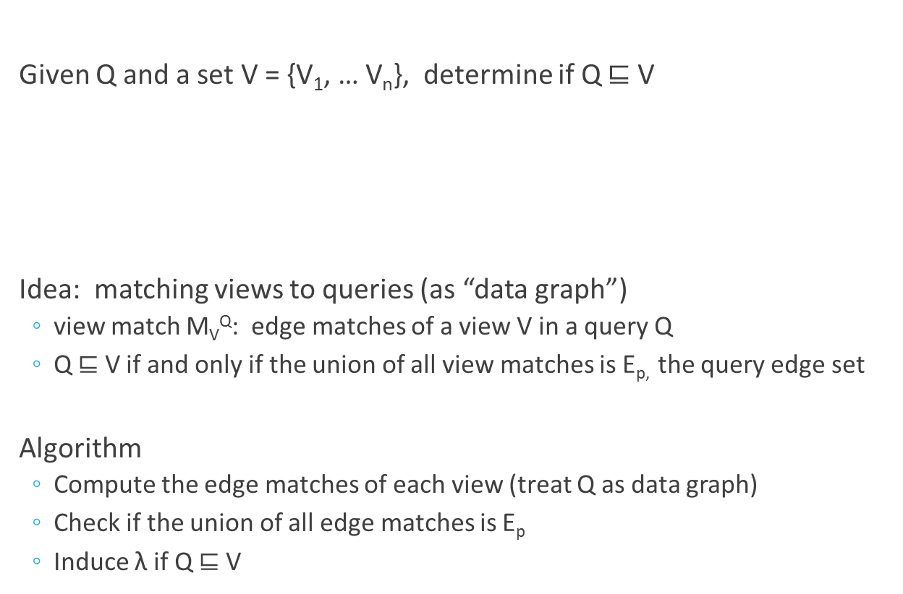

Determining Pattern containment

Slide 11
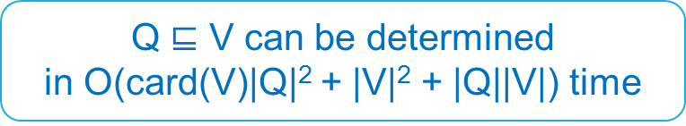
Pattern containment: example
project
manager
λ
customer
developer
project
manager
project
manager
View 1
customer
developer
customer
developer
query
as “data graph”
view matches
customer
developer
View 2

Slide 12
How to answer pattern query
using views?

Slide 13
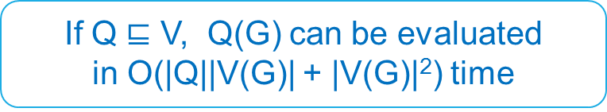
Query evaluation using views
Given Q, a set of views V and extensions, a mapping λ, find the query result Q(G)
Algorithm
  Collect edge matches for each query edge e and λ(e)
  Iteratively remove non-matches until no change happens
  Return Q(G)

Slide 14
Query evaluation using views
“bottom-up” strategy
query
project
manager
(project manager, developer) | {(PM 1, developer 2), (PM 2, developer 3)}
(project manager, customer) | {(PM 1, customer 2), (PM 2, customer 2)}
(developer, customer) | {(developer 2, customer 2), (developer 2, customer 3), (developer 3, customer 2)}
(customer, developer) | {(customer 2, developer 2), (customer 3, developer 3)}
customer
developer
project
manager
Query result
View 1
View 2
customer
developer
customer
developer
(project manager, developer) | {(PM 1, developer 2), (PM 2, developer 3)}
(project manager, customer) | {(PM 1, customer 2), (PM 2, customer 2)}
(customer, developer) | {(customer 2, developer 2), (customer 3, developer 3)}
(developer, customer) | {(developer 2, customer 2), (developer 2, customer 3), (developer 3, customer 2)}

Slide 15
What should be selected?

Slide 16

What to choose?
choose all?
project
manager
customer
customer
project
manager
developer
customer
developer
software
software
tester
view 1
view 2
query
project
manager
project
manager
developer
customer
developer
tester
customer
developer
customer
developer
software
software
view 3
view 4
software
software
view 5
view 6

Slide 17
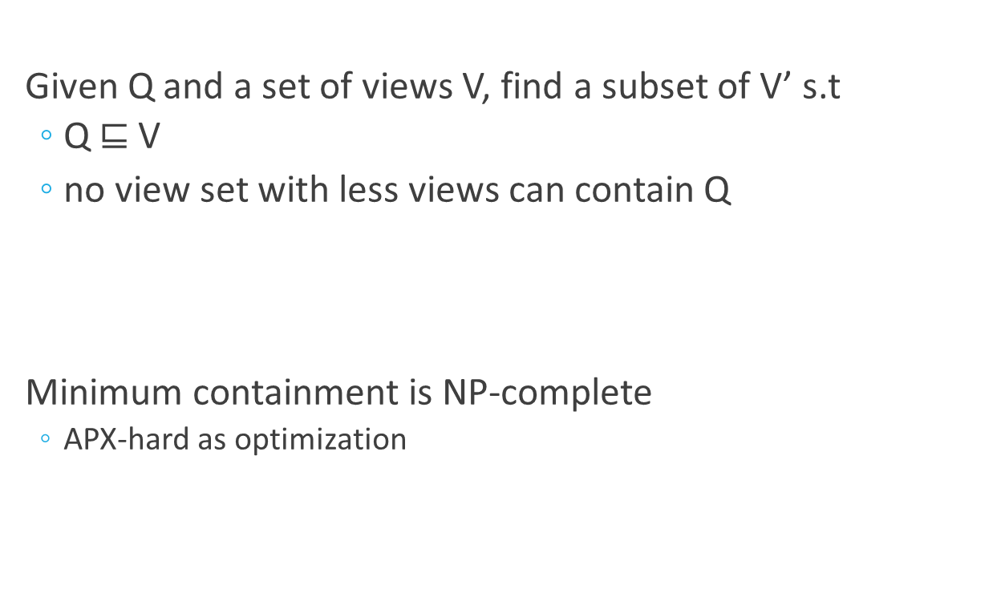
Minimum containment

Slide 18
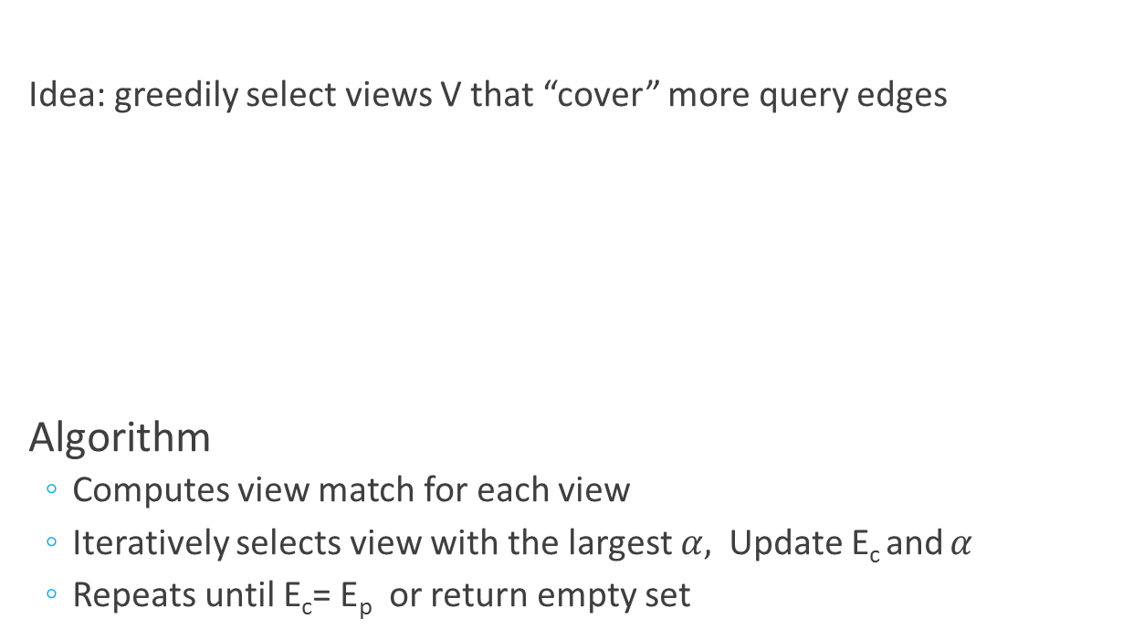
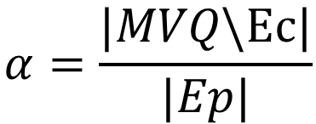
An log|E_{p}|-approximation

Slide 19





Minimum containment
Ec
project
manager
customer
customer
project
manager
developer
customer
developer
software
software
tester
view 1
view 2
query
project manager
project manager
developer
customer
developer
tester
customer
developer
customer
developer
software
software
view 3
view 4
software
software
view 5
view 6

Slide 20
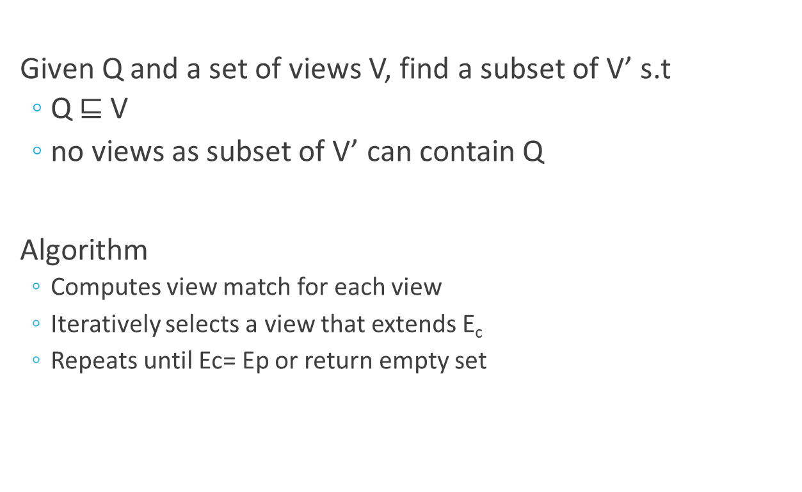
Minimal containment

Slide 21

Minimal containment
project
manager
project
manager
customer
customer
developer
customer
developer
software
view 1
software
tester
view 2
query
project manager
project manager
developer
customer
developer
tester
customer
developer
customer
developer
software
software
view 3
view 4
software
software
view 5
view 6

Slide 22
Bounded pattern matching using views
Bounded pattern queries
Answering bounded pattern queries
  Idea: “reduce” bounded pattern queries to weighted pattern queries
  View matches: weighted edge to weighted paths
  Complexity and algorithms carry over to bounded queries
project
manager
A collaborative (chat) network
PM
2
3
project
manager
tester
2
2
customer 1
customer
developer
customer 2
View 1
customer
developer
2
A collaborative pattern
customer
developer
developer 1
developer 2
View 2

Slide 23
Putting everything together
Problem |  | Complexity | Algorithm
Simulation | containment | PTIME | O(card(V)|Q|²+|V|²+|Q||V|)
 | minimum containment | NP-c/APX-hard | log|E_{p}|-approximable O(card(V)|Q|²+|V|²+|Q||V|+|Q|card(V)^{3/2})
 | minimal containment | PTIME | O(card(V)|Q|²+|V|²+|Q||V|)
 | evaluation | PTIME | O(|Q||V(G)| + |V(G)|²)
Bounded simulation | containment | PTIME | O(|Q|²|V|)
 | minimum containment | NP-c/APX-hard | log|E_{p}|-approximable O(|Q|²|V|+|Q|card(V)^{3/2})
 | minimal containment | PTIME | O(|Q|²|V|)
 | evaluation | PTIME | O(|Q||V(G)| + |V(G)|²)
Classes | Relational |  | XML | graph/RDF
language | Conjunctive query | Relational algebra | Xpath (XQuery) | RPQs | ECRPQs | (P)SPARQL | (bounded) pattern query
containment | NP-c | undecidable | coNP-c - undecidable | undecidable | undecidable | EXPTIME | PTIME

Slide 24
Experimental study

Slide 25

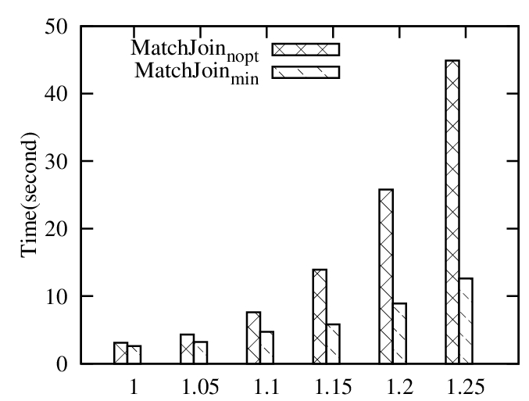
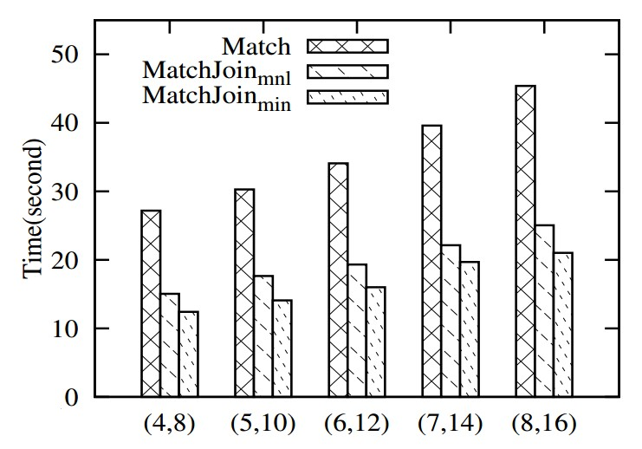
Efficiency: pattern queries
“Music”; < 7 days
greater improvement over denser graphs
“Sports”
Rate > 4
Comedy;
View > 10k
Youtube Views
2.2 times and 1.75 times faster
|E| = |V| ª
Notes:
5 million

Slide 26


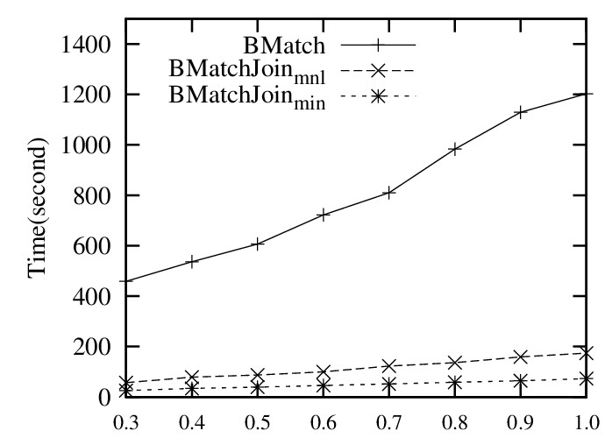

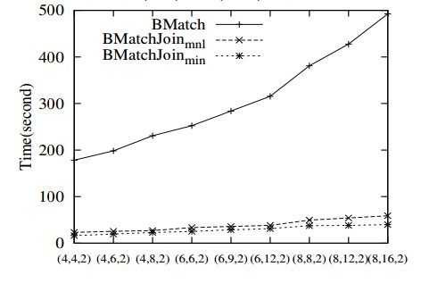
Efficiency: bounded pattern queries
“Books”; rating > 4
greater improvement over larger graphs
“Music CD”;
sales rank> 5000
10 times and 7.1 times faster
“DVD”; reviews> 1000
Amazon Views

Slide 27
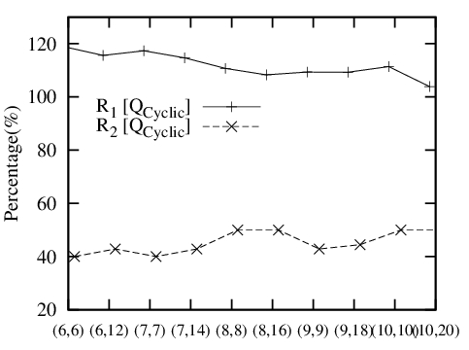
Minimum vs. Minimal
Minimum takes slightly more time to find substantially smaller sets of views

Slide 28

conclusion
Pattern containment is tractable for (bounded) pattern queries
Query evaluation using views is much more efficient for large graphs than “batch” counterparts
Journey just starts…
  More features to select good views to cache?
  When a query is not contained in existing views?
  View-based subgraph queries?

Slide 29


Answering pattern query using views
Thank you!

